Slide 1
FH Kufstein Tirol University of Applied Sciences
The Evolution of ESG in Financial Decisions
By: Swagat
Notes:
Sustainable Finance by Alex Edmans and Marcin Kacperczyk The end of ESG by Alex Edmans

Slide 2


Author details
Marcin Kacperczyk, currently Professor of Finance at Imperial College London (U.K). His main interest areas are climate finance, financial markets, financial intermediation, and asset management with approximately 14126 citations.
Alex Edmans is a British academic and economist who is professor of finance at London Business School (U.K.). Edmans' research is on corporate governance, executive pay, the real effects of financial markets, and behavioral finance, and has been cited 16,500 times.

Slide 3
Agenda
Chapter 1…………………………………………....................................................Introduction
Chapter 2………………………………………….....................................................Background
Chapter 3…………………………………………...............................................................Data
Chapter 4…………………………………………...................................................Methodology
Chapter 5…………………………………………..........................................................…Result
Chapter 6………………………………………….................................................…Presentation
Chapter 7…………………………………………...........................................Existing Literature
Chapter 8…………………………………………Statistical significance Vs Economic Significance
Chapter 9……………………………………………………………………………………………..Limitations
Chapter 10………………………………………………………………………………....Robustness check
Chapter 11…………………………………………………………………………………………….Conclusion

Slide 4
CHAPTER 1:
INTRODUCTION

Slide 5
1.1 Sustainable Finance Overview
Integration of Environmental, Social, and Governance (ESG) issues into financial decisions.
Importance of sustainability at the CEO level and in mainstream investment.
Three drivers: financial relevance, nonfinancial objectives, and investor tastes.
Notes:
Integration of Environmental, Social, and Governance (ESG) Issues into Financial Decisions
"Integrating ESG issues into financial decisions involves considering environmental impacts, social responsibilities, and governance practices alongside traditional financial metrics. This holistic approach helps identify risks and opportunities that may not be evident through financial analysis alone."
"By incorporating ESG factors, investors can enhance long-term value creation, mitigate risks, and align their investments with broader societal goals, leading to more sustainable financial performance.“
Importance of Sustainability at the CEO Level and in Mainstream Investment
"Sustainability has become a top priority for CEOs and is now integral to corporate strategy. Leaders recognize that sustainable practices can drive innovation, attract talent, and build resilient supply chains."
"Mainstream investors are increasingly factoring ESG criteria into their decisions, reflecting a growing recognition that sustainable companies are better positioned to achieve long-term success and manage emerging risks.“
Three Drivers: Financial Relevance, Nonfinancial Objectives, and Investor Tastes
"The first driver, financial relevance, emphasizes how ESG factors can impact a company's bottom line through risk management and capital efficiency. Companies with strong ESG practices often enjoy lower costs of capital and higher valuations."
"Nonfinancial objectives and investor tastes are also critical. Many investors are motivated by ethical considerations and seek to align their portfolios with personal values, leading to a shift towards sustainable investing."

Slide 6
1.2 Overview
ESG is critical to long-term value but should not be seen as niche.
Long-term factors are part of general investing, not separate.
Notes:
ESG is Critical to Long-Term Value but Should Not Be Seen as Niche
"ESG factors are fundamental to the sustained performance of companies, influencing everything from operational efficiency to brand reputation. Viewing ESG as niche overlooks its pervasive impact on financial and non-financial performance ."
"Integrating ESG into core business strategies ensures resilience and competitiveness in a rapidly evolving market landscape, where stakeholders increasingly demand sustainable practices .“
Long-Term Factors Are Part of General Investing, Not Separate
"Long-term investment strategies naturally incorporate ESG considerations, as they address systemic risks and opportunities that traditional financial analysis might miss. This integration aligns investment portfolios with enduring value creation ."
"Separating ESG from general investing is artificial; factors like climate change, social equity, and governance quality are intrinsic to evaluating a company's future prospects and stability ."

Slide 7
CHAPTER 2:
BACKGROUND

Slide 8
2.1 Early Developments & Mainstreaming of ESG
Initial focus on Corporate Social Responsibility (CSR) and socially responsible investors (SRI).
ESG becomes mainstream, included in financial decisions by traditional investors.
Notes:
Initial Focus on Corporate Social Responsibility (CSR) and Socially Responsible Investors (SRI)
"The early stages of sustainable finance concentrated on CSR and SRI, where businesses voluntarily engaged in ethical practices and investors sought to support companies aligned with their values. This period marked the beginning of integrating ethical considerations into business models and investment decisions."
"CSR initiatives aimed to address social and environmental issues, while socially responsible investors evaluated firms based on their adherence to ethical guidelines, laying the groundwork for the development of more comprehensive ESG frameworks.“
ESG Becomes Mainstream, Included in Financial Decisions by Traditional Investors
"Over time, ESG considerations evolved from niche to mainstream, with traditional investors recognizing their importance for risk management and long-term performance. This shift was driven by evidence that ESG factors can materially impact financial returns and company stability."
"Today, ESG is embedded in the investment processes of major financial institutions, reflecting a broader understanding that sustainability is crucial for both economic success and societal well-being."

Slide 9
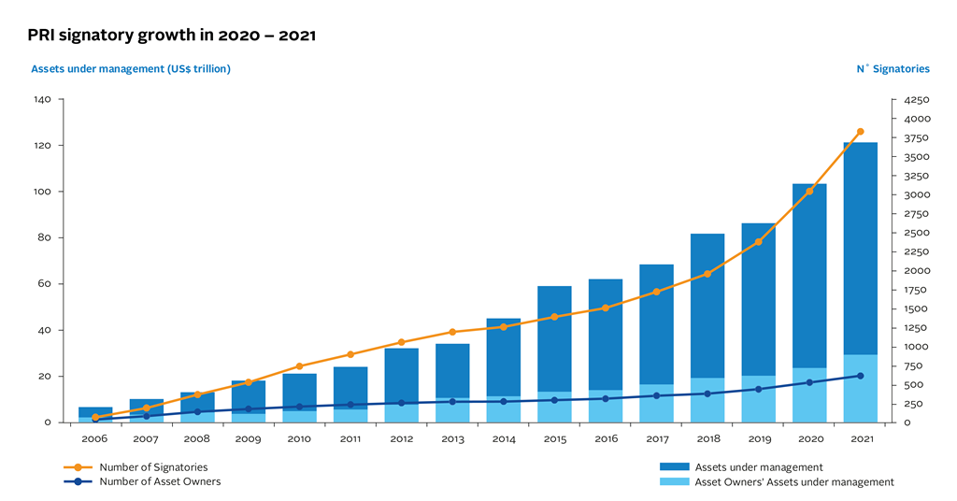
2.3 Recent Trends
Rapid growth in assets under management by UN PRI signatories from 2006 to 2021.
Increasing importance of ESG in policy and regulatory frameworks.
Notes:
Rapid Growth in Assets Under Management by UN PRI Signatories from 2006 to 2021
"The assets under management by UN PRI signatories have seen exponential growth, rising from $6.5 trillion in 2006 to over $100 trillion in 2021. This surge underscores the increasing commitment of global investors to integrate ESG principles into their investment strategies."
"This rapid growth reflects a broader recognition within the investment community that ESG considerations are essential for managing long-term risks and opportunities, driving more sustainable financial outcomes.“
Increasing Importance of ESG in Policy and Regulatory Frameworks
"Governments and regulatory bodies worldwide are increasingly embedding ESG criteria into policy frameworks, mandating greater transparency and accountability from corporations. This regulatory push ensures that companies adhere to higher standards of environmental and social governance."
"These regulatory changes are designed to promote sustainable economic growth and protect investors by ensuring that ESG risks are systematically identified and managed, aligning corporate behaviors with societal expectations."

Slide 10
CHAPTER 3:
DATA

Slide 11
3.1 Sources of ESG Data
ESG ratings from agencies like Sustainalytics, MSCI, and Refinitiv.
Financial data from sources like BlackKnight McDash for specific studies.
Survey data on household investors' environmental preferences.
Notes:
ESG Ratings from Agencies like Sustainalytics, MSCI, and Refinitiv
"ESG ratings provided by agencies such as Sustainalytics, MSCI, and Refinitiv offer critical insights into a company's performance on environmental, social, and governance issues. These ratings are used by investors to assess potential risks and opportunities associated with ESG factors."
"Each agency employs its own methodology, resulting in varied ratings for the same company. This divergence highlights the importance of understanding the specific criteria and processes used by each rating provider.“
Financial Data from Sources like BlackKnight McDash for Specific Studies
"Financial data from sources such as BlackKnight McDash is invaluable for conducting detailed empirical studies on the impact of ESG factors. This data allows researchers to analyze trends and correlations within large datasets, providing a robust basis for their findings."
"In specific studies, such data can reveal how ESG considerations influence financial performance, mortgage defaults, and investment returns, aiding in the development of more sustainable financial models.“
Survey Data on Household Investors' Environmental Preferences
"Survey data on household investors' environmental preferences sheds light on the growing trend of individual investors prioritizing sustainability in their investment choices. This data captures attitudes and behaviors that drive the demand for green financial products."
"Understanding these preferences helps financial institutions design investment products that align with the values of environmentally conscious investors, fostering greater participation in sustainable finance."

Slide 12
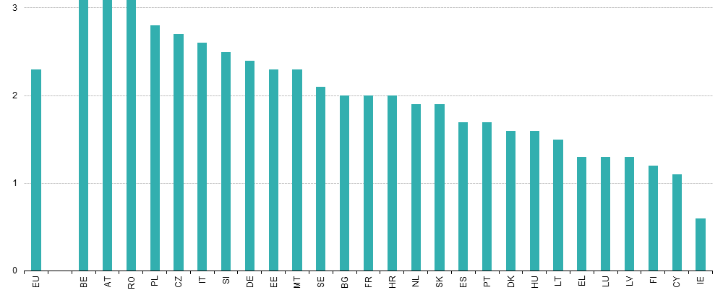
National expenditure on environmental protection in EU region (% of GDP)

Slide 13
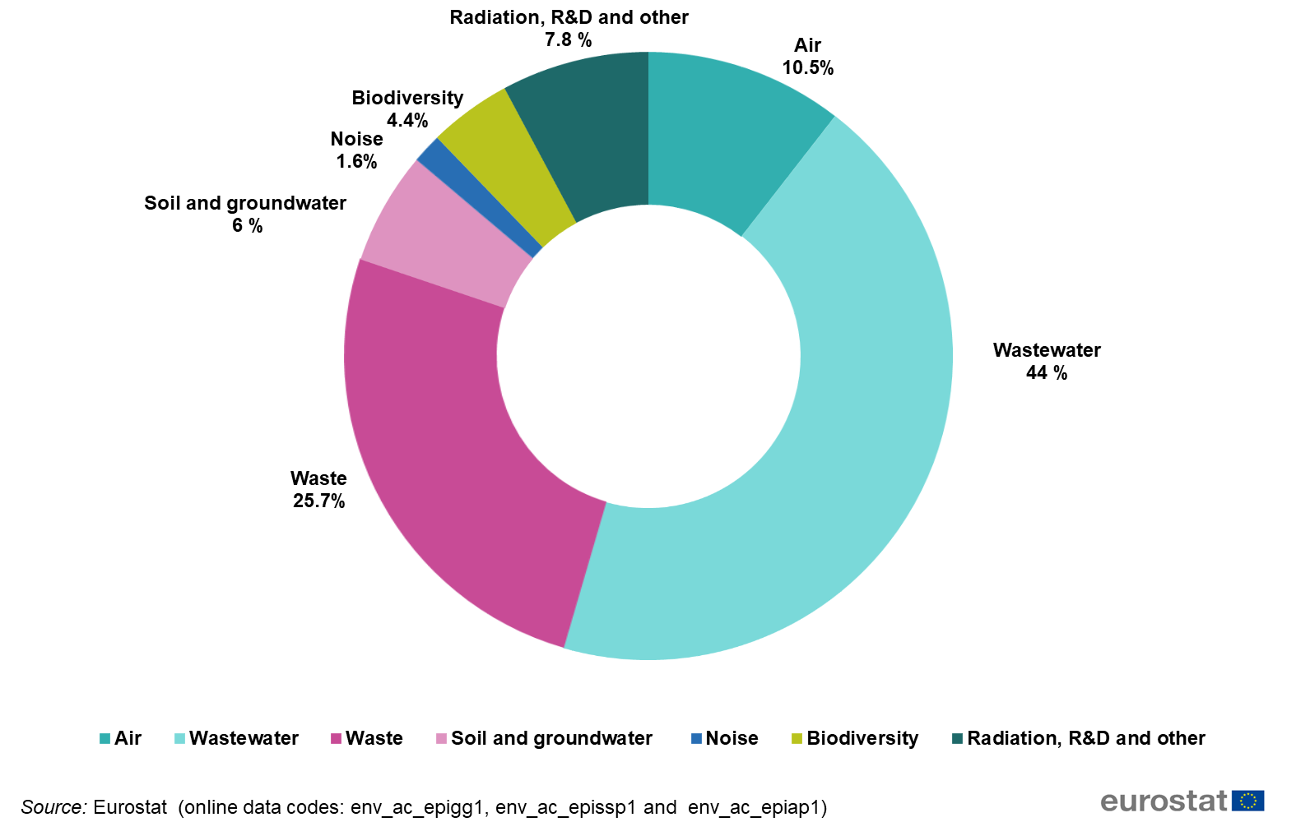
Investments for environmental protection by environmental domain in EU region

Slide 14
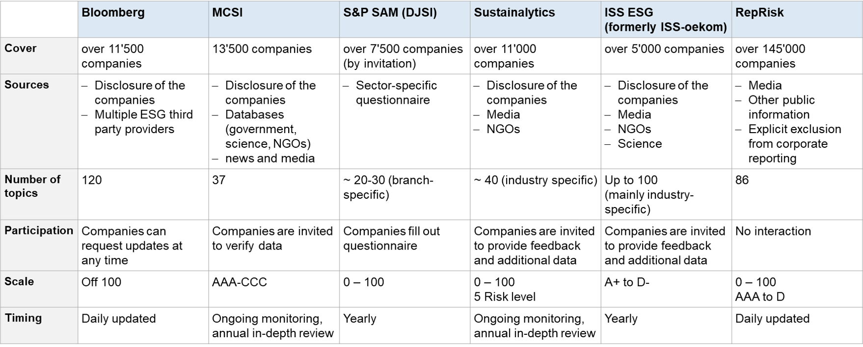
3.2 Discrepancies in ESG Ratings
Significant variation between different ESG rating agencies.

Slide 15
CHAPTER 4:
METHODOLOGY

Slide 16
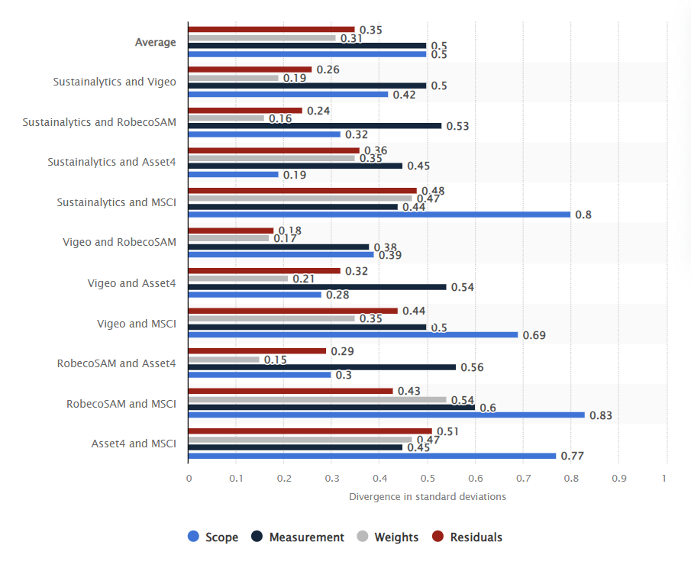
4.1 ESG Rating Analysis
Evaluation of divergence in ESG ratings among different providers
Analysis of sustainability features in portfolio decisions and their impact on expected returns.
Notes:
According to an academic study conducted in 2020, the main reasons for divergence between scores provided by five of the major environmental, social and governance (ESG) ratings agencies is because of scope and measurement. Scope refers to which issues are factored into the score, while measurement is how these performance on these issues is quantified. Based on 2017 data, there was an average of 0.5 standard deviations between providers for these two categories. Evaluation of Divergence in ESG Ratings Among Different Providers
"Different ESG rating agencies, such as Sustainalytics, MSCI, and Refinitiv, often produce divergent ratings for the same companies due to variations in their methodologies and criteria. This inconsistency can lead to confusion among investors trying to make informed decisions based on these ratings."
"Understanding the specific factors and weightings each agency uses is crucial for investors to accurately interpret ESG ratings. This evaluation helps in identifying potential biases and ensuring a more comprehensive assessment of a company's ESG performance.“
Analysis of Sustainability Features in Portfolio Decisions and Their Impact on Expected Returns
"Integrating sustainability features into portfolio decisions involves considering ESG factors that can influence long-term financial performance. Studies have shown that companies with strong ESG practices often exhibit lower risk and more stable returns."
"The impact on expected returns is significant, as portfolios that prioritize ESG factors can potentially outperform those that do not, particularly in terms of risk-adjusted returns. This analysis underscores the value of sustainability in achieving both financial and societal objectives."

Slide 17
4.2 Empirical Studies:
Use of large datasets (e.g., mortgage data, household surveys) to assess the impact of ESG factors.
Notes:
Use of Large Datasets to Assess the Impact of ESG Factors
Mortgage Data:
Impact of Sea Level Rise on Mortgage Costs: A study utilizing 1,581,600 first-lien 30-year mortgages from BlackKnight McDash reveals that properties exposed to sea level rise (SLR) incur higher interest rate spreads, with a 10.2 basis points increase in SLR-prone areas​​.
Early Financial Market Responses: Despite the long-term nature of some climate risks, financial markets are already incorporating these risks into mortgage credit costs, indicating a proactive adjustment in pricing to reflect future environmental impacts​​.
Household Surveys:
Green Investment Preferences vs. Behavior: Research involving a large sample of Swedish households found a disconnect between environmental preferences and investment behavior. Many households with green preferences did not hold green portfolios, often due to financial disengagement and informational constraints​​.
Influence of Financial Literacy: The study highlights the critical role of financial literacy in enabling households to align their investments with their environmental values. Households lacking financial literacy struggle to make informed green investment choices, often defaulting to non-ESG compliant options due to misleading fund names​​.

Slide 18
CHAPTER 5:
RESULTS

Slide 19
5.1 Impact on Asset Prices and Behavior of PRI Signatories
Evidence showing that ESG factors affect asset prices through risk-adjusted returns.
Mixed results on whether PRI signatories invest more responsibly compared to non-signatories
Notes:
Evidence Showing that ESG Factors Affect Asset Prices Through Risk-Adjusted Returns
Sustainable Capital Asset Pricing Model (S-CAPM): The S-CAPM model by Olivier David Zerbib demonstrates that expected returns can be decomposed into components reflecting exclusion preferences and tastes for ESG. Specifically, exclusion forces contribute approximately 2.7% per year to risk premia, while ESG tastes add around 2% per year​​.
Market Incorporation of ESG Risks: Financial markets already price in long-term ESG risks, such as climate change, into asset prices. This proactive adjustment indicates that firms with better ESG performance may experience lower cost of capital and enhanced risk-adjusted returns over time​​.
Mixed Results on Whether PRI Signatories Invest More Responsibly Compared to Non-Signatories
Global vs. US Signatories: Research by Gibson Brandon et al. found that non-US PRI signatories tend to have higher ESG portfolio scores compared to non-signatories. However, US signatories often exhibit similar or worse ESG ratings than their non-signatory counterparts, especially if they have recently underperformed or cater to retail clients, suggesting potential greenwashing​​.
Behavioral Differences and Motivations: The discrepancy in ESG performance between US and non-US signatories may be driven by commercial incentives and regulatory uncertainties in the US, as well as the maturity of the ESG market. These factors can lead to strategic behavior differences, such as US investors possibly engaging in ESG underperformers with the intention to improve their ratings, though evidence of actual improvement is lacking​​.

Slide 20
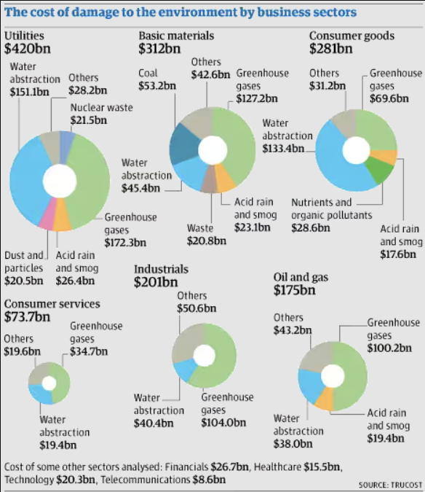
5.2 Hedging with Polluting Firms
Environmentalists might invest in polluting firms as a hedge against pollution-related risks.
Notes:
Environmentalists Might Invest in Polluting Firms as a Hedge Against Pollution-Related Risks
Hedging Against High Pollution States: Research by Baker, Hollifield, and Osambela suggests that environmentalists may invest in polluting firms as a hedge. In scenarios where pollution levels are high, polluting firms might perform well financially. By investing in these firms, environmentalists can offset their financial losses caused by adverse pollution effects on other parts of their portfolio​​.
Economic Mechanisms and Countervailing Forces: The model also identifies two forces that could potentially counter this hedging behavior: coordination among investors to internalize their impact on pollution and deriving non-financial benefits from investing in non-polluting firms. These factors could influence the overall investment strategies of environmentally conscious investors​​.

Slide 21
CHAPTER 6:
PRESENTATION

Slide 22
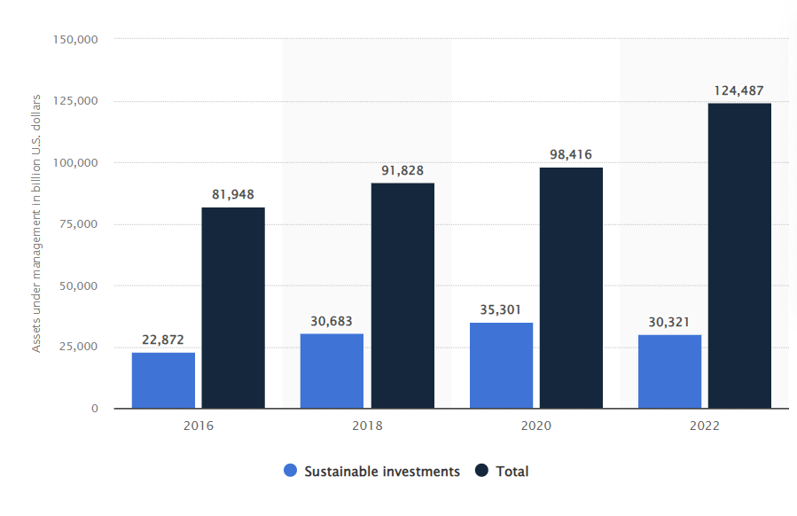
6.1 Visualizing ESG Impact
Graphs showing growth in sustainable assets under management.

Slide 23
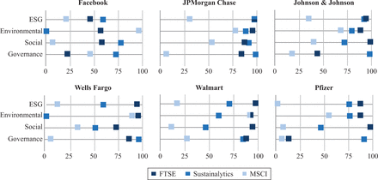
6.1 Visualizing ESG Impact (Contd…)
Charts depicting divergence in ESG ratings.

Slide 24


6.2 Case Studies
Examples of companies with improving and non-performing ESG scores.

Slide 25
CHAPTER 7:
EXISTING LITRATURE

Slide 26
7.1 Comparison with Traditional Finance & Alignment with Long-term Value Creation
ESG as an extension of traditional risk management practices.
ESG factors are essential for long-term financial and societal returns, similar to other intangibles like management quality.
Notes:
ESG as an Extension of Traditional Risk Management Practices
Holistic Risk Perspective: ESG factors provide a broader view of risks beyond traditional financial metrics. By incorporating environmental, social, and governance considerations, companies can identify and mitigate risks related to regulatory changes, reputational damage, and operational disruptions, leading to a more resilient business model .
Integration into Risk Frameworks: Incorporating ESG factors into existing risk management frameworks allows companies to proactively address potential risks and opportunities. This integration enhances long-term value creation and aligns with stakeholders' increasing expectations for sustainable and responsible business practices .
ESG Factors are Essential for Long-Term Financial and Societal Returns, Similar to Other Intangibles Like Management Quality
Sustainable Value Creation: ESG factors contribute to long-term financial performance by fostering sustainable practices that reduce costs, enhance brand loyalty, and improve operational efficiency. Companies that prioritize ESG are better positioned to adapt to changing market conditions and regulatory environments, ensuring sustainable value creation .
Intangible Asset Enhancement: Just as management quality drives organizational success, strong ESG performance enhances intangible assets such as brand reputation, employee satisfaction, and customer loyalty. These intangible benefits are crucial for long-term financial stability and societal impact, reinforcing the importance of ESG in modern business strategy .

Slide 27
CHAPTER 8:
STATISTICAL SIGNIFICANCE Vs ECONOMIC SIGNIFICANCE

Slide 28
Statistical Findings & Economic Relevance
ESG factors often show statistically significant impacts on financial metrics.
Importance of considering the economic magnitude of ESG impacts, not just statistical significance.
Notes:
ESG Factors Often Show Statistically Significant Impacts on Financial Metrics
Empirical Evidence: Numerous studies, such as those involving the Sustainable Capital Asset Pricing Model (S-CAPM), demonstrate that ESG factors significantly impact financial metrics like risk premia and cost of capital. For instance, ESG preferences and exclusion preferences can add up to 4.7% per year to risk-adjusted returns, highlighting their statistical significance in financial performance evaluations​​.
Risk Mitigation: ESG factors help in identifying potential risks that traditional financial metrics might overlook. By integrating ESG considerations, companies can better forecast and mitigate risks related to environmental regulations, social responsibilities, and governance issues, which are statistically shown to affect financial stability and performance​​.
Importance of Considering the Economic Magnitude of ESG Impacts, Not Just Statistical Significance
Beyond Statistical Significance: While ESG factors may show statistically significant impacts, it's crucial to assess the economic magnitude of these impacts. For example, a small statistically significant improvement in an ESG score might not translate into a substantial financial benefit, underscoring the need to evaluate the economic implications comprehensively​​.
Strategic Decision Making: Understanding the economic magnitude helps in making informed strategic decisions. Companies should focus on ESG factors that offer substantial economic benefits, such as cost savings from improved energy efficiency or revenue growth from enhanced brand reputation, rather than solely relying on their statistical significance​​.

Slide 29
CHAPTER 9:
LIMITATIONS

Slide 30
9.1 Variability in ESG Ratings & Greenwashing
Different methodologies and scopes among rating agencies lead to inconsistencies.
Risk of companies and investors claiming to be sustainable without meaningful actions.
Notes:
Different Methodologies and Scopes Among Rating Agencies Lead to Inconsistencies
Diverse Criteria and Weightings: ESG rating agencies often use different criteria and weightings in their assessments, leading to inconsistencies. For instance, some agencies may prioritize environmental factors while others emphasize governance aspects, resulting in varied ESG scores for the same company .
Impact on Investment Decisions: These inconsistencies can create challenges for investors seeking reliable ESG data to inform their decisions. Without standardized methodologies, investors may face difficulties in comparing ESG performance across companies, potentially leading to suboptimal investment choices .
Risk of Companies and Investors Claiming to be Sustainable Without Meaningful Actions
Greenwashing Concerns: There is a significant risk of greenwashing, where companies and investors claim to be sustainable without implementing substantive ESG practices. This misleading representation can erode trust and hinder genuine sustainability efforts .
Regulatory and Market Responses: To combat greenwashing, regulatory bodies and market participants are increasingly demanding transparency and accountability. Implementing stringent reporting standards and verification processes can help ensure that sustainability claims are backed by meaningful actions and outcomes .

Slide 31
9.3 Data Constraints
Limited availability of comprehensive and consistent ESG data across all regions and asset classes.
Notes:
Limited Availability of Comprehensive and Consistent ESG Data Across All Regions and Asset Classes
Data Gaps and Regional Disparities: The availability of ESG data varies significantly across regions and asset classes, creating substantial gaps. Developing markets often lack robust ESG reporting frameworks, leading to incomplete and inconsistent data that hinders comprehensive analysis .
Challenges in Standardization: The lack of standardized ESG metrics exacerbates these inconsistencies. Different regions and sectors prioritize various aspects of ESG, resulting in fragmented data that complicates efforts to compare and assess ESG performance on a global scale .

Slide 32
CHAPTER 10:
ROBUSTNESS CHECK

Slide 33
10.1 Cross-Verification & Sensitivity Analysis
Comparing results using different ESG rating providers to ensure robustness.
Testing the sensitivity of results to various assumptions and data sources.
Notes:
Comparing Results Using Different ESG Rating Providers to Ensure Robustness
Cross-Verification of ESG Scores: Comparing ESG ratings from multiple providers helps identify discrepancies and ensures a more comprehensive understanding of a company's ESG performance. This cross-verification can reveal biases or gaps in one provider's methodology, leading to more robust investment decisions .
Enhanced Decision-Making: Utilizing diverse ESG data sources mitigates the risk of relying on potentially flawed or incomplete information from a single provider. This approach enhances the robustness of ESG assessments and supports better-aligned investment strategies with sustainability goals .
Testing the Sensitivity of Results to Various Assumptions and Data Sources
Scenario Analysis: Conducting sensitivity analyses by varying key assumptions and using different data sources helps assess the robustness of ESG-related findings. This method allows investors to understand how changes in assumptions impact financial outcomes and ESG performance, leading to more resilient strategies .
Risk Mitigation: Testing the sensitivity of results ensures that ESG assessments are not overly dependent on specific datasets or assumptions. This practice helps identify potential vulnerabilities in investment decisions and promotes a more adaptive and informed approach to ESG integration .

Slide 34
CHAPTER 11:
CONCLUSION

Slide 35
11.1 Key Takeaways
ESG is crucial for long-term investment strategies but should not be seen as a separate niche.
Effective integration of ESG factors can enhance both financial and societal outcomes.
Notes:
ESG is Crucial for Long-Term Investment Strategies but Should Not Be Seen as a Separate Niche
Integrated Approach: ESG considerations should be integrated into mainstream investment strategies rather than treated as a separate niche. This integration ensures that sustainability factors are incorporated into the overall risk assessment and value creation processes, leading to more resilient and future-proof portfolios .
Holistic Value Creation: Viewing ESG as an integral part of investment strategy enhances long-term value creation. It aligns financial objectives with broader societal goals, ensuring that investments contribute positively to both financial performance and social impact .
Effective Integration of ESG Factors Can Enhance Both Financial and Societal Outcomes
Enhanced Financial Performance: Effective ESG integration can lead to improved financial outcomes by identifying and mitigating risks, uncovering opportunities, and driving operational efficiencies. Companies with strong ESG practices often experience lower costs of capital and better market performance .
Positive Societal Impact: Incorporating ESG factors not only boosts financial returns but also generates positive societal outcomes. This dual benefit helps in addressing global challenges such as climate change, social inequality, and corporate governance issues, contributing to a more sustainable and equitable world .

Slide 36
11.2 Future Research Directions
Need for more studies on non-US data, private companies, and the effects of policy on sustainability.
Exploration of contrarian views and the broader impacts of sustainable finance practices.
Notes:
Need for More Studies on Non-US Data, Private Companies, and the Effects of Policy on Sustainability
Global and Private Sector Insights: There is a significant gap in ESG research focusing on non-US data and private companies. Expanding the scope of studies to include these areas will provide a more comprehensive understanding of global ESG practices and their impacts across different markets and sectors .
Policy Influence on Sustainability: Investigating how various policies influence sustainability outcomes is crucial. Policies can drive or hinder ESG adoption, and understanding their effects can help in formulating strategies that promote sustainable practices across diverse regulatory environments .
Exploration of Contrarian Views and the Broader Impacts of Sustainable Finance Practices
Evaluating Criticisms: It is essential to explore contrarian views that question the effectiveness and practicality of sustainable finance practices. These perspectives can highlight potential shortcomings and areas for improvement, ensuring a more balanced and robust approach to ESG integration .
Broad Societal Impacts: Examining the broader impacts of sustainable finance practices on society can reveal both intended and unintended consequences. Understanding these impacts helps in refining ESG strategies to maximize positive outcomes while mitigating any negative effects .

Slide 37
FH Kufstein Tirol University of Applied Sciences
The End
Thank you

